Slide 1
Susceptibility to Change Analysis for San Marcos, TX
By:
Aggiornamento
Jorge Morales- Project Manager, GIS Analyst​
Thomas Middleton- GIS Analyst​
Timothy Szpakowski- GIS Analyst

Slide 2
Overview
Purpose​
Project Parameters​
List of Task​
Scope​
Updates to Methodology​
Results​
Limitations and Sources of Error
Conclusion
Sources and acknowledgements

Slide 3
Summary
In 2015, the U.S Census recognized the City of San Marcos (COSM) as the fastest growing city in the country for the third year in a row. (U.S Census) Like any successful growing city, guiding land development is crucial.
This semester, Aggiornamento worked alongside the City of San Marcos, Planning and Development Service, to conduct a citywide susceptibility to change analysis to provide insight on land use trends and to identify areas that have a higher redevelopment probability. This analysis is an important tool that will assist with the city's plan

Slide 4
Problems and Solutions
Problems
Solution
Rapid growth and redevelopment.
Redevelopment can lead to the character of an area to change.
Locate areas that have a high probability to change. This will help the city manage redevelopment projects.
Neighborhood character studies provides insight to an areas unique features, land use patters, ect.

Slide 5
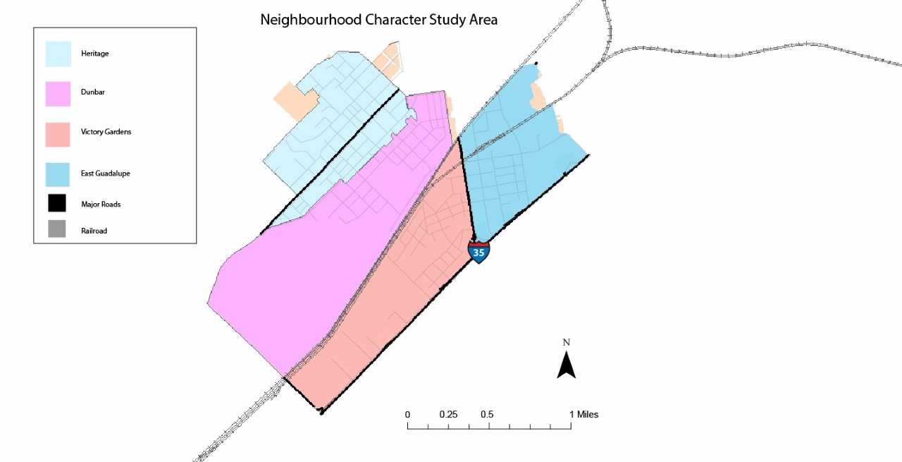
Scope
City of San Marcos
Over all susceptibility to change analysis
Heritage Area (Created by the city using CONA neighborhoods)
More in depth focus

Slide 6
Data
Entity | Attributes | Spatial Object | Source
Roads | Street Name | Line | COSM
Parcel | Address, Land/Improvement Values, Owner occupancy | Polygon | COSM/Hays CAD
Historic Districts | General Area | Polygon | COSM
Zoning | Zoning Codes | Polygon | COSM
Neighborhood Character Study | Comments, General Area | Point | COSM
Flood Damage | Area | Polygon | COSM
Flood plains | Area | Polygon | FEMA
The data provided:

Slide 7
Data
Accuracy
Issues and Conversions
2016 Parcels had missing values. To use the most up to date data we had, we combined the data from 2015 to fill in gaps in the 2016 data.
Data had to be converted into raster format prior to the overlay analysis. This was done using a cell size of 50 feet.
A random sample of 30 parcel data was compared to the Hays County Appraisal District (Hays CAD) website for accuracy.

Slide 8
Methodology- City wide analysis
Primary tool- Overlay tool (weighted sum)
Factor used
Land to Improvement ratio
Historic Districs
Owner occupancy
Zoning
Comments
Walkscore

Slide 9
Methodology- City wide analysis
Major Steps
Review data (missing values, accuracy)
Creating layers based on corresponding factors.
Raster Conversion
Applying weights to factors.
Create results map.

Slide 10
Methodology- Factors explained
Factors
Heritage Districts
Owner Occupancy
Land to Improvement ratio
Council of Neighborhood Associations (CONA)
Walkscore
Zoning
Comments

Slide 11
Methodology- Neighborhood Character Study
Major Steps
Fieldwork (photographs)
Analyzed comments in the area
Neighborhood comparison
Susceptibility within study area

Slide 12
City wide results
Neighborhoods: 32
High Probability: 7
Low Probability: 16
Mid Probability: 9

Slide 13
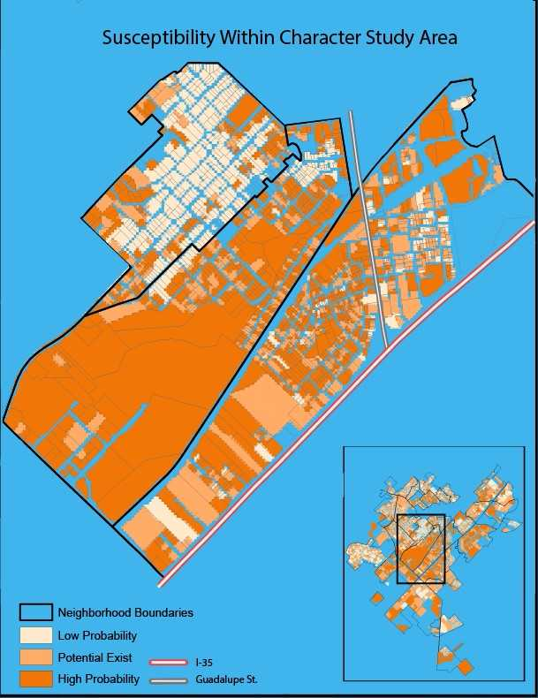
Study Area Results
Neighborhoods: 4
High Probability: 3
Low Probability: 1

Slide 14
Neighborhoods within study area
Neighborhoods
Heritage
Dunbar
Victory Gardens
East Guadalupe

Slide 15
Neighborhood Character Result
General overview of the Area
Flood zones
Damage from 1998 Flood
Parks
Historic Districts
Zoning

Slide 16
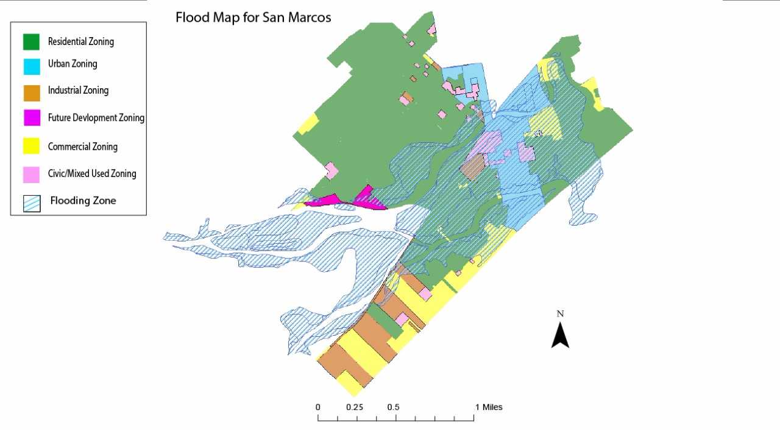
Flood Zones

Slide 17
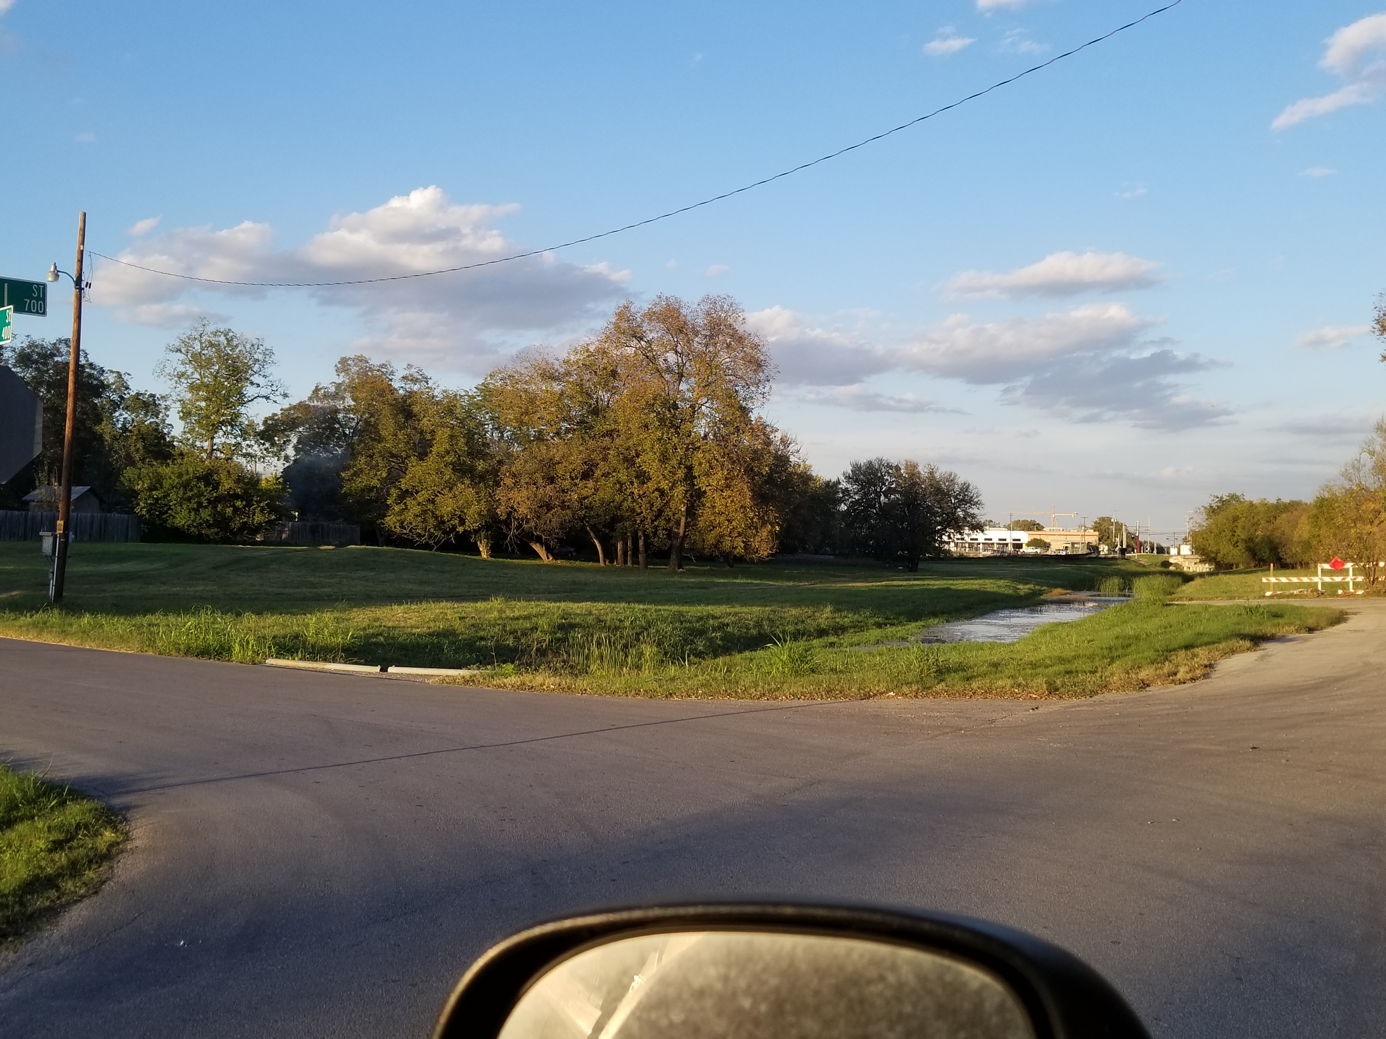
Examples of Flood Area in Victory Gardens

Slide 18
1998 Flood Damage
Two factors of damage
Monetary amount
Parcels that were in any way affected (low spots, etc.)

Slide 19
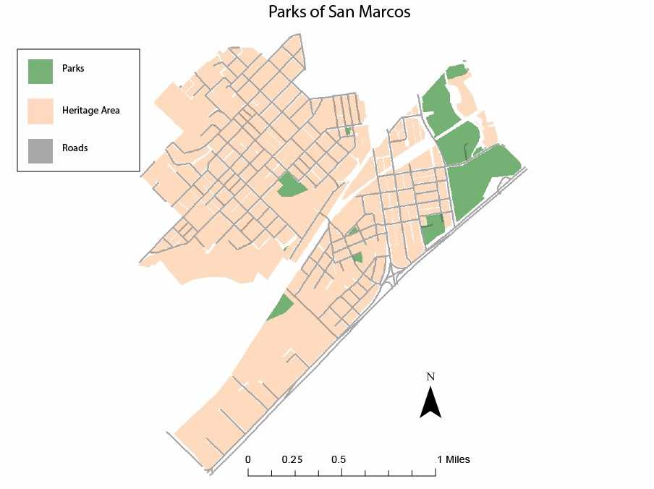
Parks
Parks are a important part of a neighborhoods character.
Parks are aesthetic areas that people want to live near.
1
3
2

Slide 20
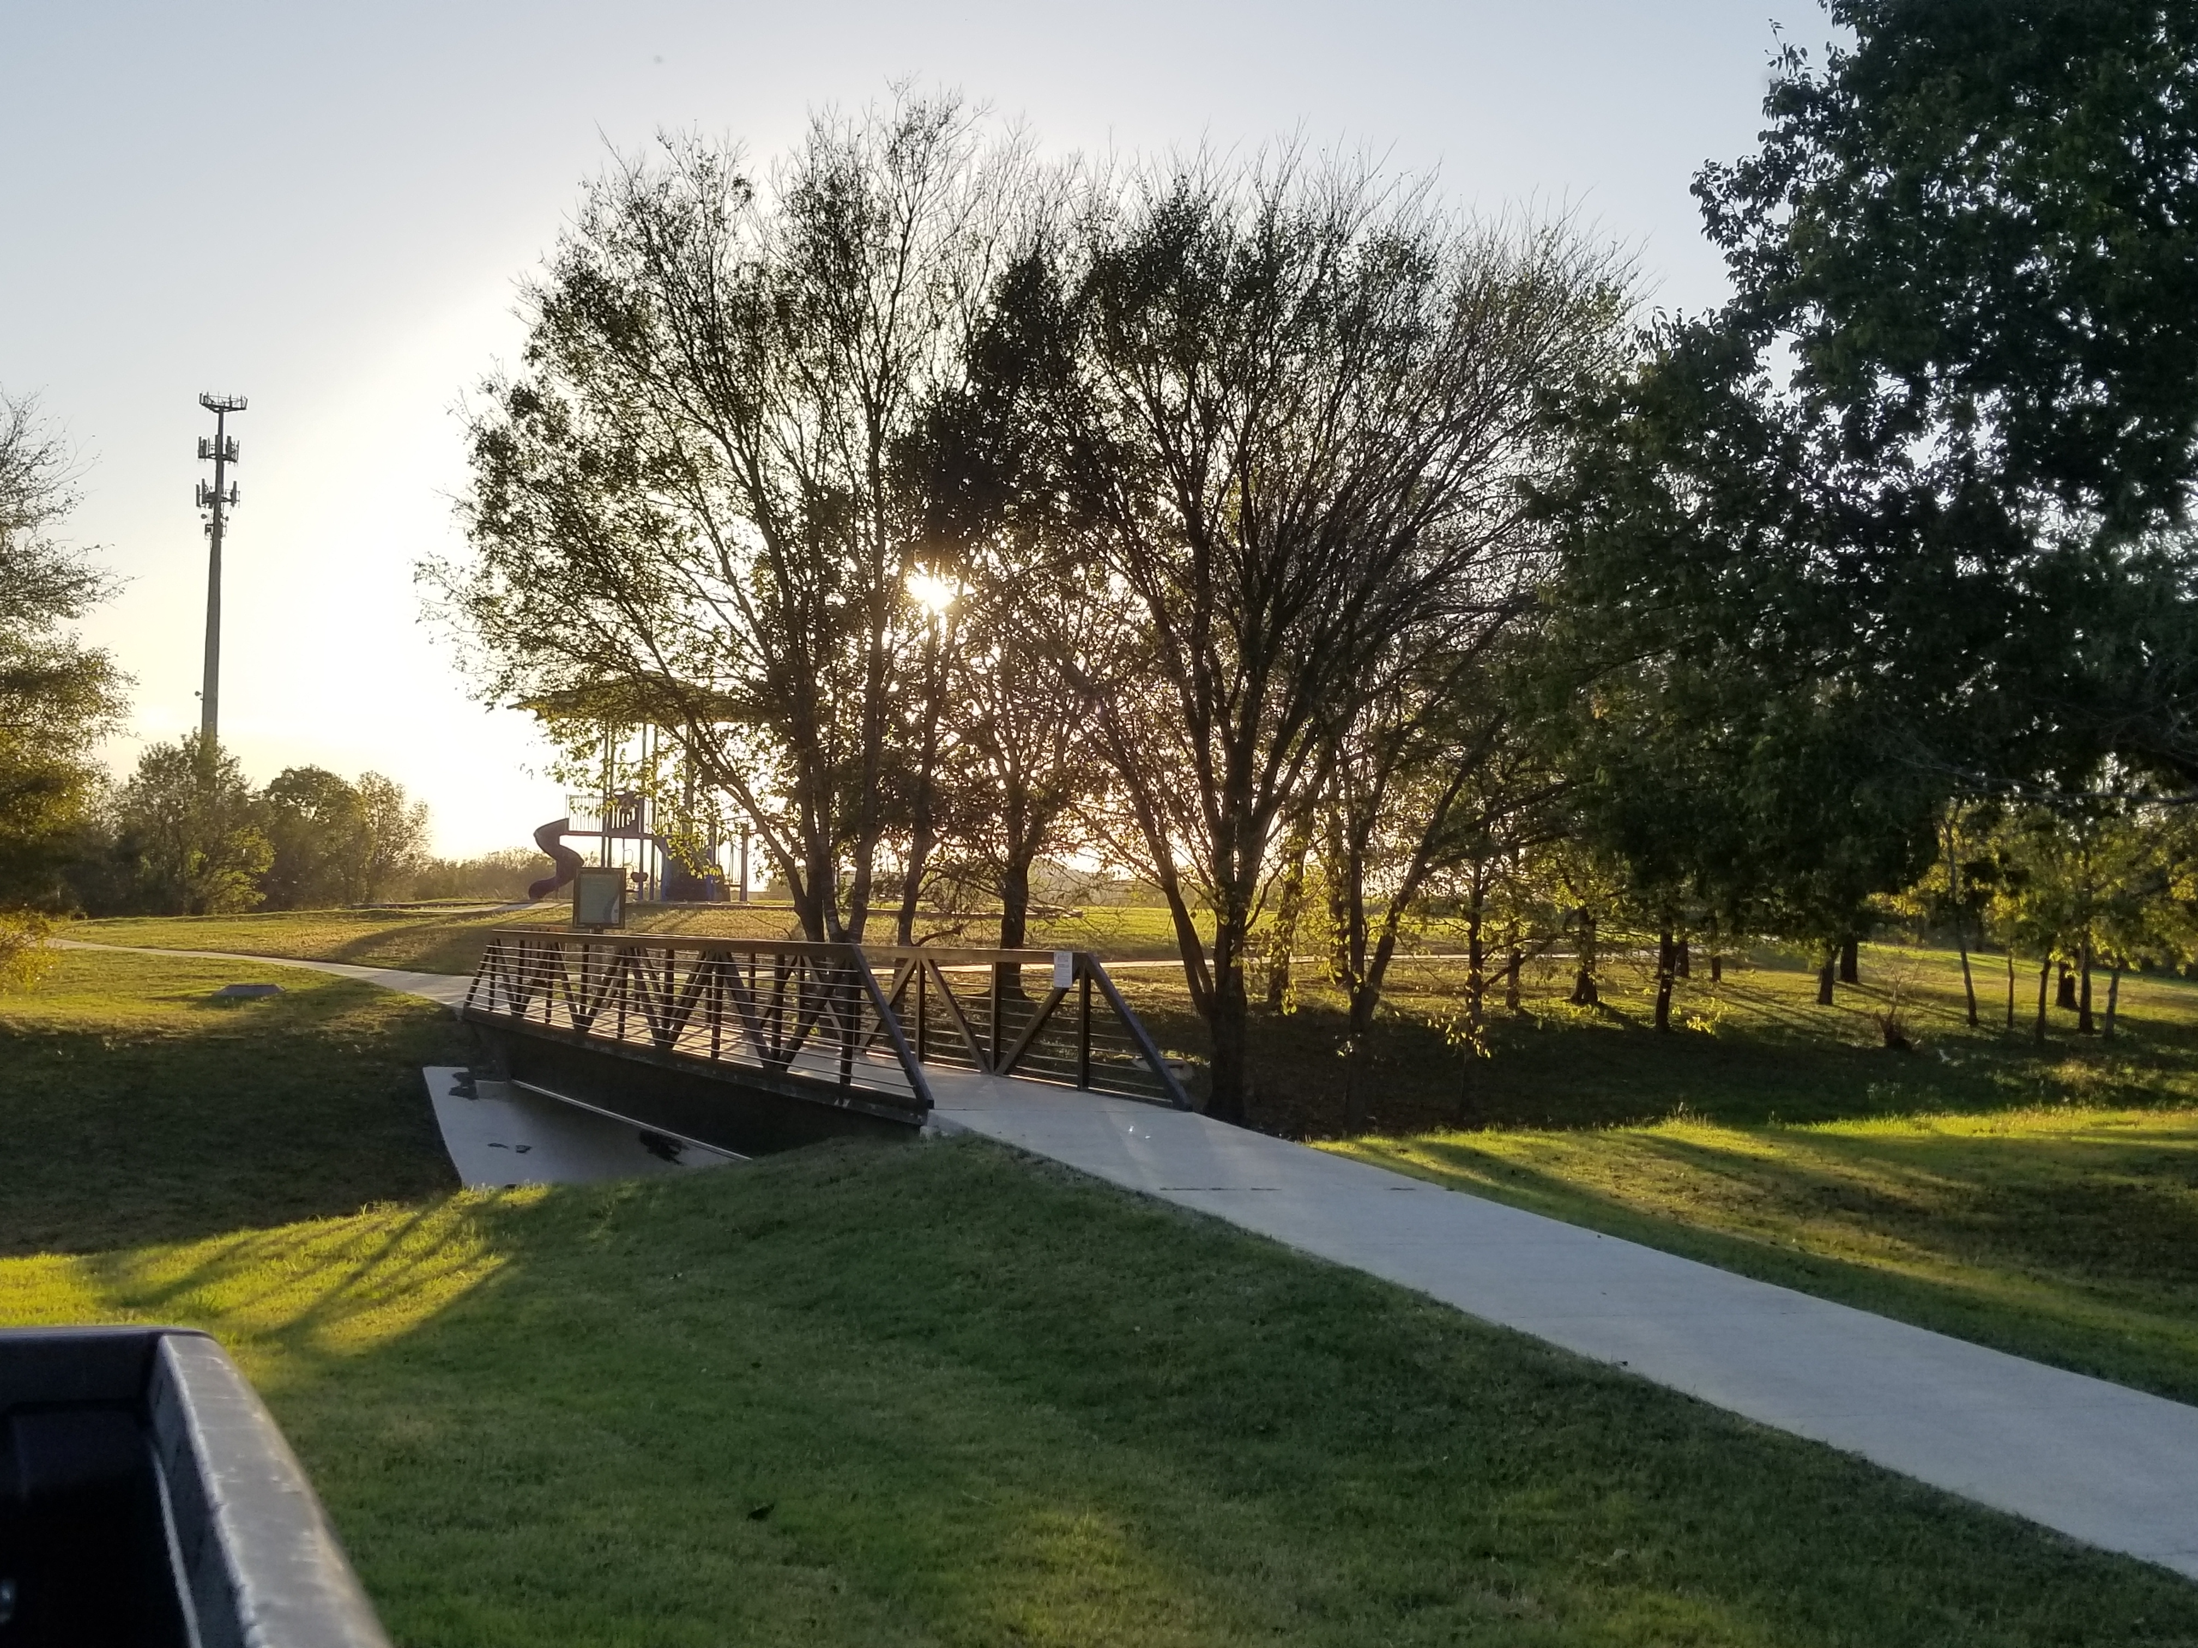
Park Locations of Examples
2
1
3

Slide 21
Historic Districts
Historic landmarks are primarily in the Heritage Neighborhood
This usually denotes not being susceptible to change.

Slide 22
Zoning
Areas of dedicated residential zones.
Areas of zones that are multifaceted.
Future developments are here today!

Slide 23
Examples of Neighborhood Characteristics- Victory Gardens
Neighborhood Grocery
Neighborhood Restaurant

Slide 24
Limitations
Missing data for parcels in some factors. (resulted in parcel gaps in the end results)
Comments (misrepresentation)
Modifiable areal unit problem (MAUP) using neighborhood boundaries vs smaller blocks

Slide 25
Conclusion
The city of San Marcos has potential to continue to grow as it is influenced by factors such as Texas State University and proximity to two major Texas cities. While there appears to be room for areas to supply the demand of future changes that may occur, it is important for the city to plan accordingly.
In our opinion, the city of San Marcos now has areas of interest to focus their future plans for innovation and renewal of neighborhoods with rich history and heritage.
It is also our opinion that a more in depth look would be easily attained if certain sets of data were updated with the latest information.

Slide 26
Sources and Acknowledgements​
Data:
City of San Marcos​
Expertise: ​
Phillicia Phillips​
Abigail Gillfillan​
Nathaniel Dede-Bamfo​
Dr. Yuan

